Slide 1
Technology for Success: Computer Concepts

Slide 2
Module 8
Program and App Use and Development

Slide 3
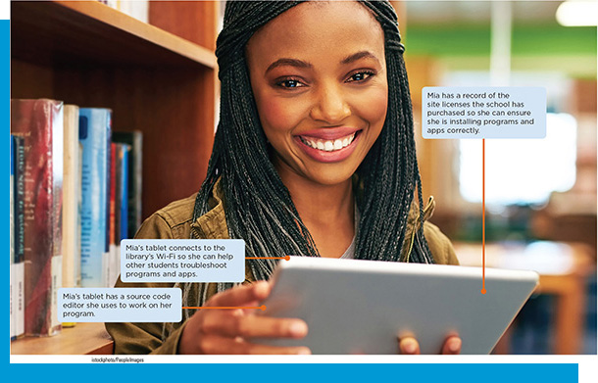
Lesson Objectives
Use various kinds of legitimate software for everyday computer tasks
Categorize the different types of software development and programming
Describe the methods associated with developing software
Describe the tools and strategies critical to software development

Slide 4
Use Software for Everyday Tasks (1 of 2)
Explain the purpose of access control technologies in digital rights management
Acquire legitimate software
Install software
Update software
Use native software

Slide 5
Use Software for Everyday Tasks (2 of 2)
Use non-native software from the public domain
Explain how to troubleshoot challenges with software

Slide 6
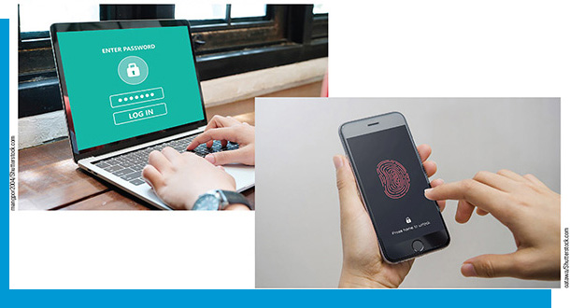
Digital Rights Management
Issues with copyright law lead to the development of digital rights management (D R M)
A strategy designed to prevent illegal distribution of movies, music, and other digital content, including programs and apps
Access controls
License agreement

Slide 7
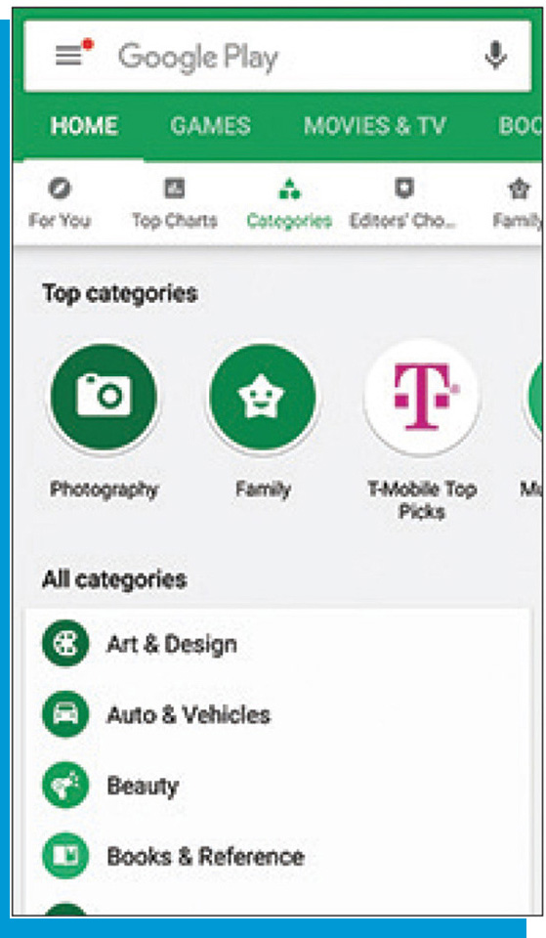
Acquiring Legitimate Software
Table 8-1: Program and App Types
Type | Description
Retail | Meets the needs of a wide variety of users, such as an operating system or productivity suite
Custom | Created with a company or set of users’ unique needs in mind to perform functions specific to a business or industry
Shareware | Copyrighted and distributed for free for a trial period, after which you must send payment to continue using the program
Freeware | Copyrighted and provided at no cost, but the developer retains all rights to the product
Open source Programs and apps (including operating systems) that have no restrictions from the copyright holder regarding modification and redistribution; users can add functionality and sell or give away their versions to others | Provided for use, modification, and redistribution, without restrictions from the copyright holder
Public domain | Donated for public use and has no copyright restrictions
Software as a Service (SaaS) Software that is distributed online for a monthly subscription or an annual fee. | Copyrighted software that is distributed online for a monthly subscription or an annual fee
Native app An app written for a specific operating system and installed on a computer or mobile device. | Created and optimized to run on a specific device or platform/operating system

Slide 8
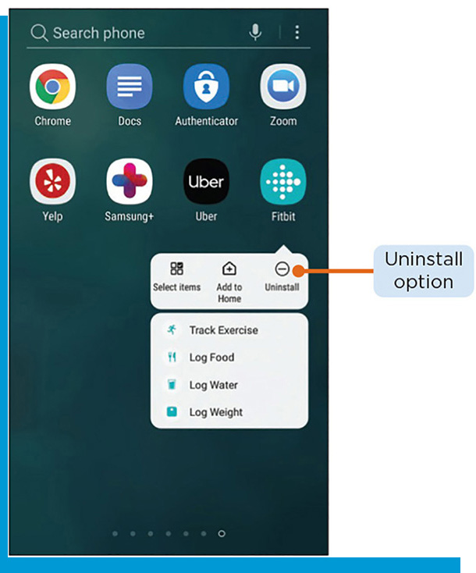
Install Software
Registration: typically optional, allows for syncing of accounts across multiple devices
Activation: usually required upfront or after a trial period
To uninstall an app, use the uninstaller tool that comes with the operating system
Uninstalling unused apps frees up storage space

Slide 9
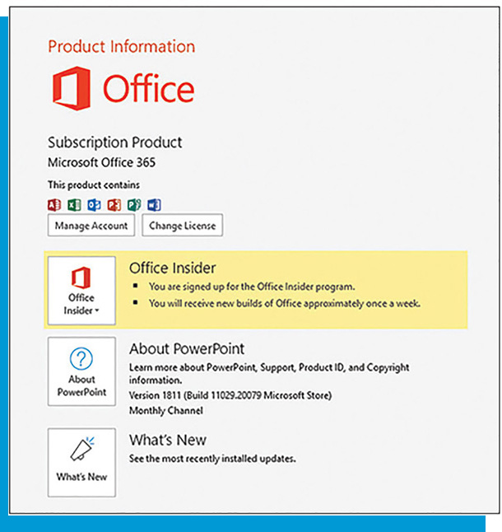
Update Software
Can provide additional functionality or address security or other issues
Mobile apps typically update automatically
Some SaaS programs allow for automatic updates as well
Types of updates
Patches
Service packs
Upgrades

Slide 10

Use Native Software
Most computers and devices come with preinstalled programs and apps
System software
Games and productivity software
Read the license agreement before accepting terms
Embedded software

Slide 11
Use Non-Native Software from the Public Domain
Do not have restrictions on use, distribution, or modification
Lack of a patent, copyright, or trademark does not mean a program is public domain
Types of free programs
Freeware
Shareware
Public domain

Slide 12
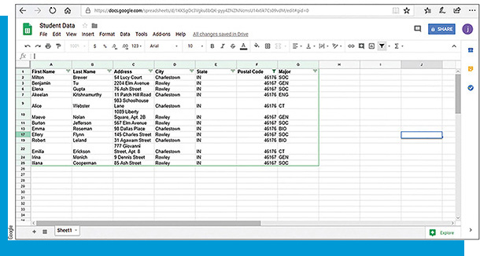

Troubleshooting Software Challenges (1 of 2)
When a crash occurs, try the following troubleshooting steps:
Note any error messages that are displayed
Save data while working to avoid losing it
Restart the program
Reboot and try running the program again
Check for software updates
Search reliable Internet sources for known solutions
Scan for viruses or malware
Uninstall and reinstall the app

Slide 13
Troubleshooting Software Challenges (2 of 2)
Troubleshooting tools:
Process managers
System information lists
Auditing tools
Patch finders
Restorers

Slide 14
Software Development and Programming
Define the key terms associated with software development
Define the key terms associated with object-oriented programing
Explain the differences between various types of software

Slide 15
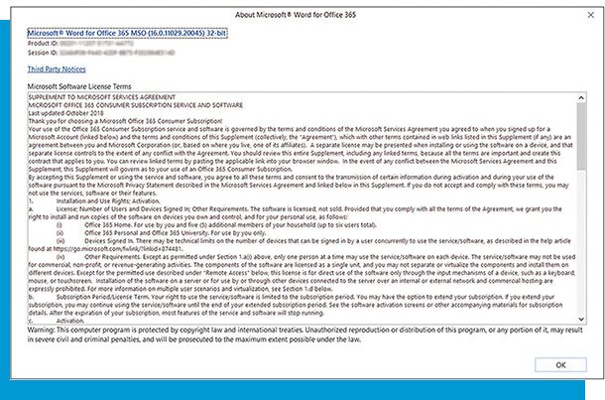
Key Terms Associated with Software Development
Table 8-2: Types of License Agreements
Type | Description
Single user or End user license agreement (E U L A) | Grants permission for one installation
Multiple-user license agreement | Lets a specified number of users access the program or app
Site license | Allows an organization to provide access to as many users as they want, either by individual installations or providing network access or Internet passwords

Slide 16
Key Terms Associated with Object-Oriented Programming
Object-oriented programming (O O P)
Object
Class
Method
Allows for the ability to reuse and modify existing objects, which provides for faster development
Guidelines
Determine on which device the program will run
Explore the capabilities of each language or tool
Consider at which speed the program will run
Determine the type of environment the program offers

Slide 17
Differences Between Various Types of Software
Programs and apps by category
Productivity (business and personal)
Graphics and media
Personal interest
Communications
Security
Antivirus
Antispyware
Antispam
Firewall
File, disk, and system

Slide 18
Methods Associated with Developing Software
Outline the key components of the software development process
Explain the differences between the key development methodologies
Discuss the phases in the system development lifecycle

Slide 19
Key Components of the Development Process (1 of 2)
Tables 8-4: Development Team Roles
Role | Duties
Project manager | A person dedicated to coordinating project components and ensuring that each member is progressing as planned. Oversees the product’s team, budget, and schedule. Reports to the development company’s management.
Designer | Develops the program’s user interface, including colors, fonts, and layout.
Programmer | Writes code or uses a product development app to create the program’s specifications.
Testers | Review every aspect and functionality of a program to ensure it works as intended.
I T department | Interacts with customers and users of the product to assist them with any issues that arise.

Slide 20

Key Components of the Development Process (2 of 2)
User Experience (U X) comes into play during all aspects of the process
Wireframes indicate how a user gets from one area of the program to another
General Guidelines
Group activities into phases
Involve users from whom the program is being developed
Consider at which speed the program will run
Define the standards the developers should follow to create a product with consistent results

Slide 21
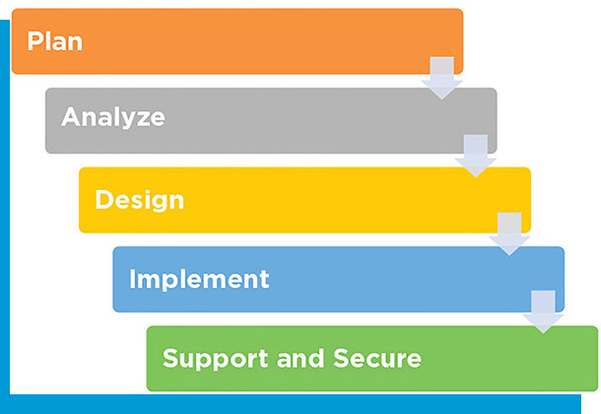
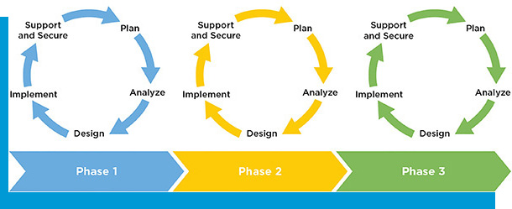
Differences Between Key Development Methodologies
Predictive development
Waterfall method
Agile development/adaptive development
Rapid application development (R A D)
DevOps

Slide 22
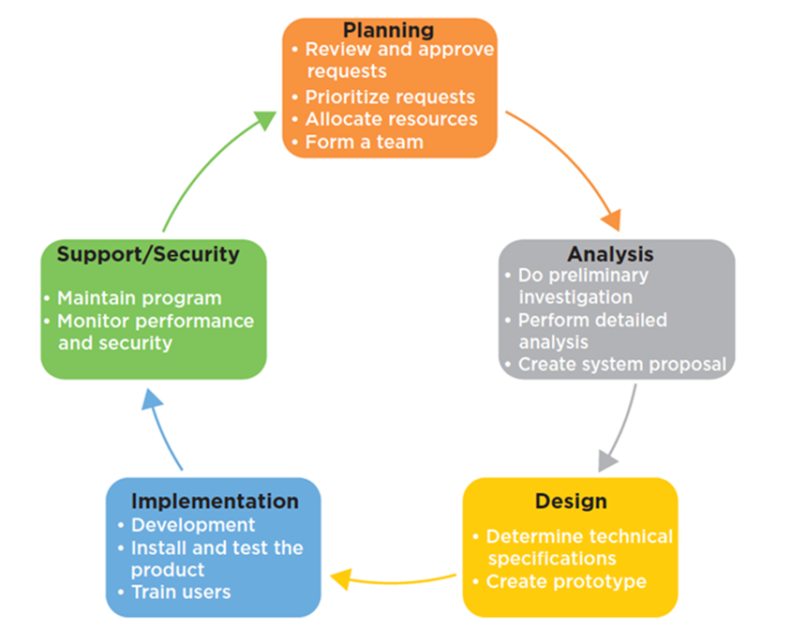
Phases in the System Development Lifecycle
The Software Development Life Cycle (S D L C)

Slide 23
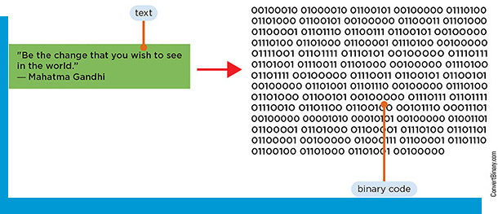
Tools and Strategies Critical to Software Development
Explain the differences between various types of programming languages
Explain the differences between various types of programming tools

Slide 24
Programming Languages (1 of 2)
Several hundred programming languages exist; each has its own syntax
Low-level
Machine languages
Assembly languages
Procedural
4G Ls

Slide 25
Programming Languages (2 of 2)
Table 8-5: Commonly Used Programming Languages
Language | Description
C | Stable language that uses the Unix environment. Developed in 1972, but still in use today.
C++ | Developed in the 1980s as an alternative to C. Flexible language that includes predefined classes.
C# | High-level language with English-language commands used to create apps for Microsoft platforms.
HTML | The standard language used to create websites; HTML uses tags to instruct the browser.
Java | Flexible O O P language commonly used to create apps for servers, as well as video games and mobile apps.
JavaScript | Essential tool for creating interactive features to add to websites.
P H P | Flexible language used by WordPress and other platforms to add functionality to websites and connect them with databases.
Python | Interpreted, O O P language commonly used to create scientific modeling apps, as well as data mining.
Ruby | Object-oriented language known for using English-language commands to create apps quickly, including those for simulations and 3D modeling.
S Q L | Used to manage, access, and search for database content.
Swift | Open-source language developed by Apple for use in creating apps for iOS.

Slide 26
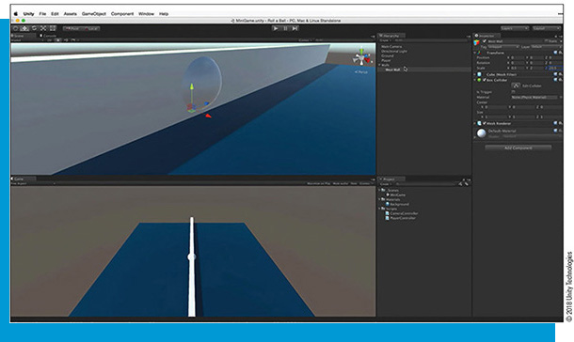
Differences Between Programming Tools
Source code editor
Debuggers
Compiler
Interpreter
Integrated development environment (I D E)
Code repositories

